Slide 1
Data Augmentation

Slide 2
Requirement of Data Augmentation
In machine learning (ML), the situation when the model does not generalize well from the training data to unseen data is called overfitting.
The first step in tackling this problem is to actually know that your model is overfitting. That is where proper cross-validation comes in.
After identifying the problem, you can prevent it from happening by applying regularization or training with more data. Still, sometimes you might not have additional data to add to your initial dataset.

Slide 3
What is Data Augmentation?
Data Augmentation is a technique that can be used to artificially expand the size of a training set by creating modified data from the existing one. It is a good practice to use DA if you want to prevent overfitting, or the initial dataset is too small to train on, or even if you want to squeeze better performance from your model.
Let’s make this clear, Data Augmentation is not only used to prevent overfitting. In general, having a large dataset is crucial for the performance of both ML and Deep Learning (DL) models. However, we can improve the performance of the model by augmenting the data we already have. It means that Data Augmentation is also good for enhancing the model’s performance.

Slide 4
You can augment:
Audio
Text
Images
Any other types of data
We will focus on image augmentations as those are the most popular ones.

Slide 5
Data Augmentation techniques
For example, for images we can use:
Geometric transformations – you can randomly flip, crop, rotate or translate images, and that is just the tip of the iceberg
Color space transformations – change RGB color channels, intensify any color
Kernel filters – sharpen or blur an image
Random Erasing – delete a part of the initial image
Mixing images – basically, mix images with one another. Might be counterintuitive but it works
For text there are:
Word/sentence shuffling
Word replacement – replace words with synonyms
Syntax-tree manipulation – paraphrase the sentence to be grammatically correct using the same words
Other described in the article about Data Augmentation in NLP
For audio augmentation you can use:
Noise injection
Shifting
Changing the speed of the tape
And many more

Slide 6
Data augmentation is a process of artificially increasing the amount of data by generating new data points from existing data. This includes adding minor alterations to data or using machine learning models to generate new data points in the latent space of original data to amplify the dataset.
A question may arise about the difference between augmented data and synthetic data.
Synthetic data: When data is generated artificially without using real-world images. Synthetic data are often produced by Generative Adversarial Networks
Augmented data: Derived from original images with some sort of minor geometric transformations (such as flipping, translation, rotation, or the addition of noise) in order to increase the diversity of the training set.

Slide 7
The importance of Data Augmentation
Improves the performance of ML models (more diverse datasets).
Data augmentation methods are widely used in practically every cutting-edge deep learning application such as object detection, image classification, image recognition, natural language understanding, semantic segmentation, and more.
Augmented data is improving the performance and results of deep learning models by generating new and diverse instances for training datasets.
Reduces operation costs related to data collection.
Data collection and data labeling can be time-consuming and expensive processes for deep learning models. Companies can cut operational expenses by transforming datasets using data augmentation techniques.

Slide 8
Limitations of Data Augmentation
Cost of quality assurance of the augmented datasets.
Research and Development to build synthetic data with advanced applications.
Verification of image augmentation techniques like GANs is challenging.
Finding an optimal augmentation strategy for the data is non-trivial.
The inherent bias of original data persists in augmented data.

Slide 9
How does Data Augmentation work?
A convolutional neural network (CNN) is invariant to translation, viewpoint, size, or illumination. Hence, CNN is able to classify accurately objects in different orientations.
Deep learning models like CNNs have a large number of parameters that help in learning these complex differentiating features by iteratively “looking” through a lot of examples. Hence, the performance of deep learning models depends on the type and size of the input dataset.
State-of-the-art computer vision models such as RESNET (60 M) and Inception-V3 (24M) have a huge number of parameters to learn complex features. Natural Language Processing (NLP) models such as BERT (340M) have even more parameters.
In order to build a deep learning model, we will have to gather a lot of data.

Slide 10
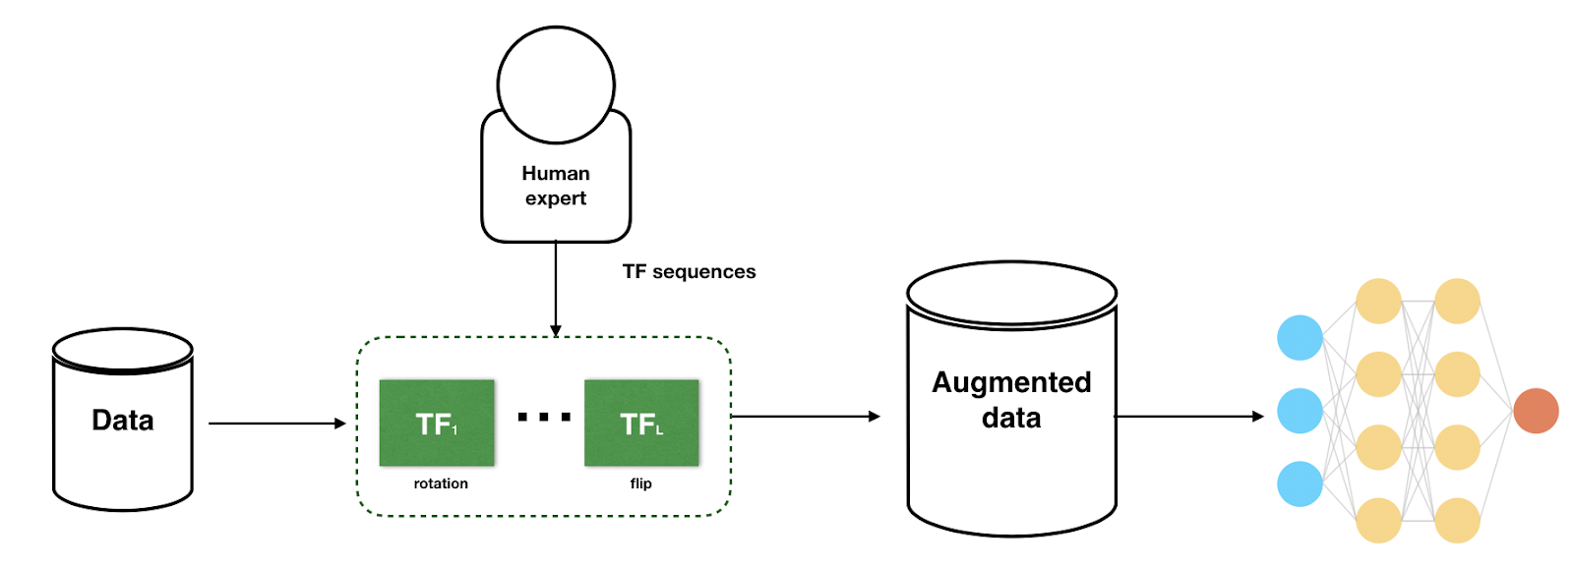
A generic data augmentation workflow in computer vision
Unfortunately, for many applications, we don't have access to large amounts of data. Data augmentation is a method to deal with the issue of limited data. In data augmentation, we opt to use a few techniques that artificially increase the amount of data from the existing data and address this problem.

Slide 11
A generic data augmentation workflow in computer vision tasks has the following steps:
1. Input data is fed to the data augmentation pipeline
2. The data augmentation pipeline is defined by sequential steps of different augmentations
TF1: Rotation
TF2: Grayscale to RGB
TF3: Blur
TFN: Flip
3. The image is fed through the pipeline and processed through each step with a probability.
4. After the image is processed, the human expert randomly verifies the augmented results and passes the feedback to the system.
5. After human verification, the augmented data is ready to use by the AI training process.

Slide 12
Data Augmentation techniques in Computer Vision
1. Position Augmentation
Center Crop: Crops the given image at the center. Size is the parameter given by the user.
Random Crop: Crop the given image at a random location.
Random Vertical Flip: Vertically flips the given image randomly with a given probability.
Random Horizontal flip: Horizontally flip the given image randomly with a given probability.
Random Rotation: Rotate the image by some angle.
Resize: Resize the size of the input image to a given size.
Random Affine: Random affine transformation of the image keeping center invariant.

Slide 13
Data Augmentation techniques in Computer Vision
2. Color Augmentation
Brightness: One way to augment is to change the brightness of the image. The resultant image becomes darker or lighter compared to the original one.
Contrast: The contrast is defined as the degree of separation between the darkest and brightest areas of an image. The contrast of the image can also be changed.
Saturation: Saturation is the separation between the colors of an image.

Slide 14
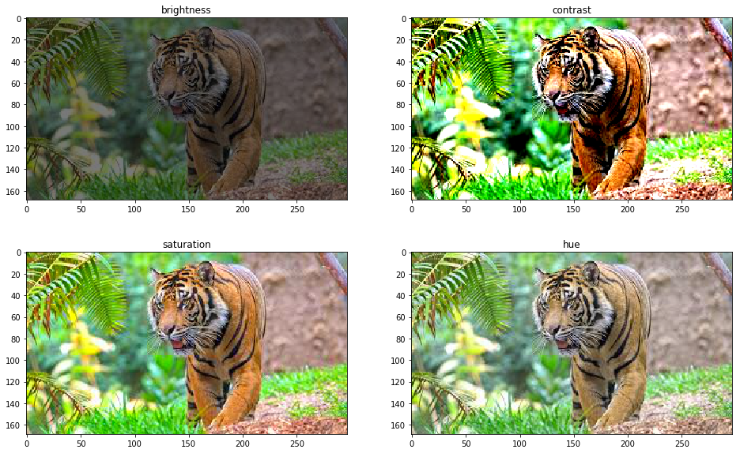
Color augmentations on image of a tiger

Slide 15
Advanced models for data augmentation
Adversarial training/Adversarial machine learning
Adversarial attacks are imperceptible changes to images (pixel-level changes) that can completely change the model prediction. In order to handle this issue, in adversarial training, images are transformed till the deep learning model is deceived and the model fails to correctly analyze the data.
These transformed or augmented images are used in the training examples to make the model robust toward adversarial attacks.

Slide 16
Advanced models for data augmentation
Generative adversarial networks (GANs)
GANs are widely used to generate synthetic images in a target domain.
The synthetic generated images by the GANs are used as augmented images for the input to the model. However, this would end up training the generator and discriminator and also the classifier (based on the use case). The downside to using GANs is that it needs high resource consumption and effort.

Slide 17
Data Augmentation use cases Healthcare
In medical imaging applications, curating datasets is not a viable option because acquiring a large number of annotated samples from experts is time-consuming and expensive. the network trained with augmentation needs to be more robust and accurate than expected variations of the same X-Ray images.
In the below figure, although we can scale the dataset count by augmentations, certain augmentations are not recommended for the given task. For instance, random rotation and reflection on the x-axis are not appropriate for the X-ray images. Hence, the data augmentation technique is different for each task.

Slide 18
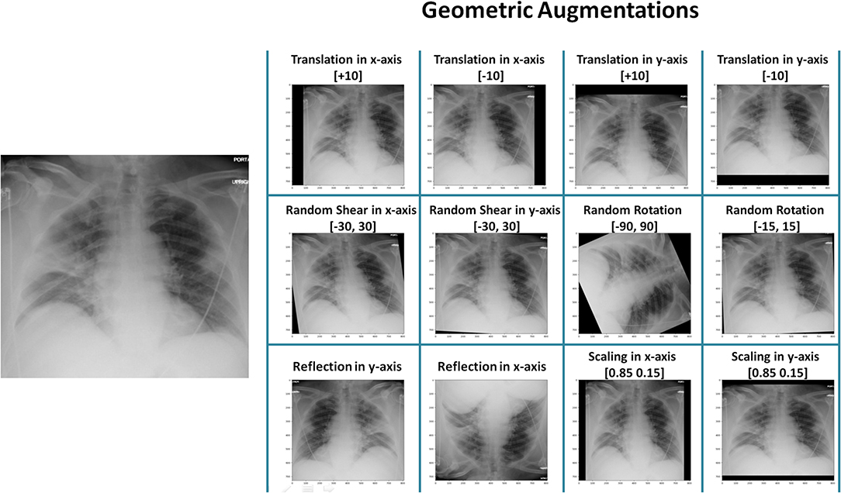
Geometric Augmentations on Xray images of the heart

Slide 19
Data Augmentation: Key takeaways
Data augmentation is a process of artificially increasing the amount of data by generating new data points from existing data.
Data augmentation techniques comes down to processes within position augmentation and color augmentation.
Advanced models for data augmentation include adversarial machine learning, GANs, and neural style transfer.
Data augmentation is used in situations where collecting large amounts of data is difficult. Healthcare and autonomous vehicles are two of the most prominent industries leveraging this method.

Slide 21
https://www.v7labs.com/blog/data-augmentation-guide

